Slide 1
Time magazine
Person of the Year

Slide 2
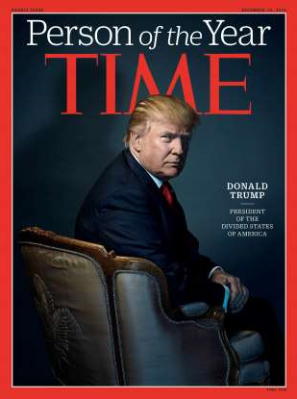
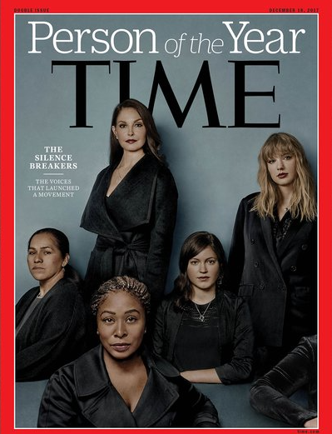
Each year, Time creates a list of candidates for their “Person of the Year” edition. Readers vote in, and the winner is featured on the cover with an article inside the magazine. Check out two recent examples from 2016 and 2017.

Slide 3
Note the addition of text:
Identification of person/group of the year
A brief description/introduction
DONALD TRUMP
_____
PRESIDENT OF THE DIVIDED STATES OF AMERICA
THE
SILENCE
BREAKERS
_____
THE VOICES THAT LAUNCHED A MOVEMENT

Slide 4
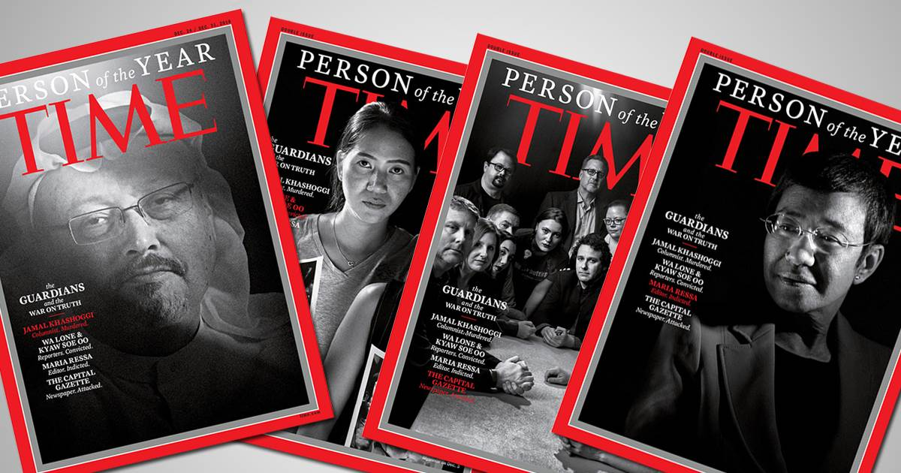
NOTE: 2018’s Person of the Year named The Guardians, or those involved in journalism. There were four different covers, and the brief description/intro read “War on Truth.”

Slide 5
Your Task:
Put yourself on the
2019 Time
“Person of the Year”
cover

Slide 6
DIRECTIONS
You can either download a blank Time “Person of the Year” template/put it into a word document (see last slide) or upload your pic into an online template: http://magazineyourself.com/create/17
*Note…once you’ve uploaded your pic, just screencap from there; you don’t need to “save and continue” to download the program. Your cover doesn’t need to be full size, but please make it fill about a half sheet of paper. Scissor-cut it down to size before submitting so it looks more authentic.
2. You will need to add text (like the samples. Feel free to use Word or another digital editing program).
Identify yourself
Create a brief subtitle/explanation/introduction (think about what would make you news-worthy. Please be attentive to your tone.)
3. Include a typed (doubled spaced), paragraph explaining more about why Time has selected you for its cover (be creative/original with tone).

Slide 7
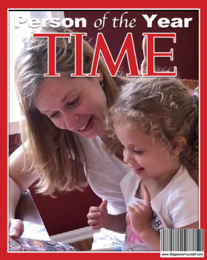
In my follow-up paragraph, I would explain about the most important role that I play: Bestie. After my niece, Emma, was born in 2015, “Aunt Colleen” seemed so tedious; my brother came up with “Bestie,” and it stuck. So, I could take a sentimental tone as I tell you about how much she melts me, like when she sang “Can’t Stop the Feeling” as she twirled through Target; or when she trips and falls, only to bounce up and exclaim, “I’m okay, guys!”; or when we eat choco tacos on the beach; or when she finishes the sentences as we read our favorite stories.
COLLEEN
REMAR
----
BESTIE

Slide 8
In my follow-up paragraph, I could talk about myself as a teacher of AP English Students, who are abbreviated in online/college board materials as A.P.E.S. So, I could take a funny or sarcastic tone. My A.P.E.S. are among the best minds at East, and I join them on the journey to smart. Maybe I could employ language typical of an adventure/sci-fi piece (words like battle, galactic, experiment, orbit, creature, force field, space, new frontier, future).
COLLEEN REMAR
----
LANDING ON
THE
PLANET OF THE A.P.E.S.

Slide 9
SUBMISSION REMINDERS—when you bring your work to class, you need:
Your cover, printed in color and blown up to about half a sheet of paper (or bigger! ☺). Make sure you cut off extra white space so it really looks like a cover.
Your brief paragraph/explanation typed and clipped to the cover.
In that explanation, highlight words/phrases that create a tone, and at the bottom of the paper, identify a tone word that best characterizes your piece.
*If you don’t have a color printer, see me in advance of the due date for a pass to the library.

Slide 10
If you want to work with a blank template, try these:
http://1.bp.blogspot.com/_GfqMyDmvo3M/TPbHDrLm-JI/AAAAAAAAAxo/-2gcywWE91E/s1600/TIME+Template.jpg
http://www.wikihow.com/images/thumb/6/62/2012-04-29_1312_700.png/537px-2012-04-29_1312_700.png

